Slide 1

Expert talk safe and trusted AI
From Basics to AGI: Understanding Modern Intelligence Systems
V HARIHARA SESHU

Slide 2
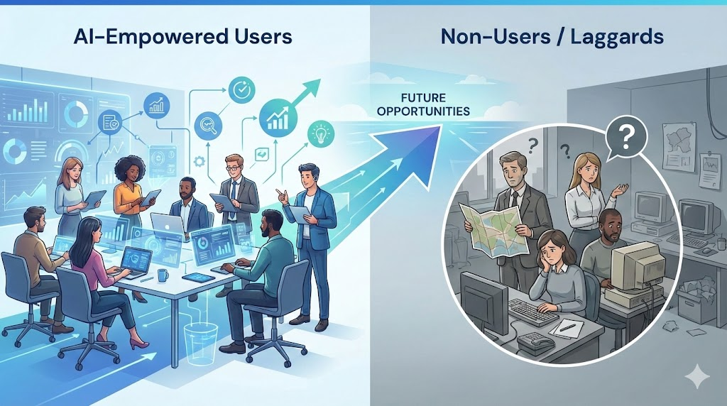
Why This Session Matters
AI is not just hype — it's infrastructure
Every major tech company is AI-first
AI is reshaping:
• Jobs and career paths
• Business models and revenue streams
• Creativity and content creation
• Research and scientific discovery
Understanding AI = Future-proofing your career

Slide 3





What is Artificial Intelligence?
Machines performing tasks requiring human intelligence
Learning
Improving from experience
Reasoning
Logical decision-making
Decision-Making
Autonomous choices
Perception
Understanding input
Examples: Netflix recommendations • Fraud detection • Self-driving cars

Slide 4
The AI Taxonomy
Understanding the Core Ecosystem
Artificial Intelligence (AI)
The Universe
Machine Learning (ML)
Systems that learn from data — The Solar System
Deep Learning (DL)
Multi-layered neural networks — Planet Earth

Slide 5

Machine Learning — The Foundation
"Instead of programming rules, we train models using data"
Linear Regression
Predicting continuous values like prices • House price prediction
Random Forest
Classification & decision trees • Spam detection
Logistic Regression
Binary classification problems • Disease diagnosis
Support Vector Machines
Finding optimal decision boundaries • Image classification

Slide 6

Deep Learning — The Powerhouse
Uses Artificial Neural Networks to unlock modern AI capabilities
Why It Matters
Applications
• Handles massive datasets
• Learns complex patterns
• Powers modern AI systems
• Achieves human-level performance
• Enables transfer learning
• Image recognition
• Voice assistants
• Chatbots & LLMs
• Autonomous vehicles
• Medical diagnosis

Slide 7
Specialization 1: Natural Language Processing
Deep Learning applied to human language
Chatbots
Conversational AI assistants
Text Summarization
Condensing long documents
Translation
Real-time language conversion
Code Generation
Writing software from descriptions
Large Language Models (LLMs)
OpenAI's ChatGPT • Anthropic's Claude • Google's Gemini • Meta's Llama

Slide 8
Specialization 2: Computer Vision
Deep Learning applied to images and video
Face Detection
Identifying faces in images
Use: Security systems
Medical Imaging
Analyzing X-rays and scans
Use: Disease detection
Autonomous Driving
Understanding road scenes
Use: Self-driving cars
Surveillance
Monitoring and tracking
Use: Safety systems
Object Detection
Locating items in images
Use: Retail & logistics
Image Generation
Creating new visuals
Use: Art & design
Leading Models: Midjourney • DALL-E 3 • Stable Diffusion • OpenAI Sora

Slide 9

Specialization 3: Speech & Audio AI
Voice AI is growing extremely fast
Speech-to-Text
Converting spoken words to written text
Examples: Meeting transcription • Voice notes
Text-to-Speech
Generating natural-sounding speech from text
Examples: Audiobooks • Accessibility tools
Voice Cloning
Replicating human voices with AI
Examples: Content creation • Dubbing
Real-time Translation
Instant language conversion in speech
Examples: International calls • Travel
Leading Tools: ElevenLabs • Google Assistant • Siri • Alexa • Call Center Automation

Slide 10
The Intelligence Spectrum
Narrow AI
AGI
ASI
Task-Specific Intelligence
Artificial General Intelligence
Artificial Super Intelligence
Systems designed for one specific task
Human-level intelligence across all domains
Intelligence beyond human capability
• Spotify recommendations
• Face unlock
• Chess engines
• Spam filters
• Reason across contexts
• Transfer knowledge
• Learn like humans
• Solve novel problems
• Solve impossible problems
• Recursive self-improvement
• Beyond human comprehension
Current State
10-20 Years Away
Theoretical

Slide 11

The AI Roadmap — Step-by-Step
Step 1
Foundations
• Linear Algebra & Calculus
• Probability & Statistics
• Python Programming
2-3 months
Step 2
Data & Classic ML
• Data handling (Pandas, NumPy)
• Classic ML (Scikit-learn)
• Model evaluation metrics
2-3 months
Step 3
Neural Networks
• Deep Learning fundamentals
• PyTorch / TensorFlow
• Training & optimization
3-4 months
Step 4
Specialization
• Choose: NLP, CV, or Speech
• Advanced architectures
• Real-world projects
2-3 months

Slide 12
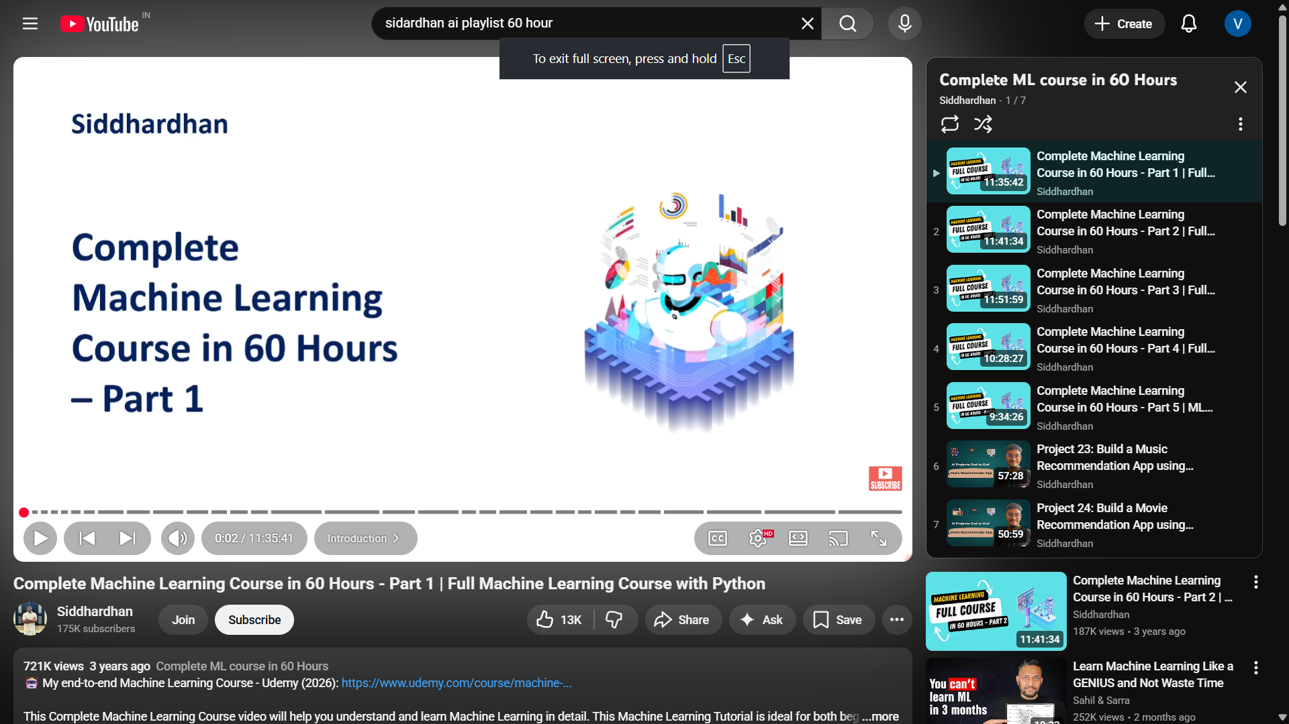
The Fast Track Strategy
❌ Random tutorials and scattered learning
✅ Follow a structured roadmap
Siddhardhan's Complete ML Playlist (60+ hours)
✓ Precision & Recall metrics
✓ Classification models
✓ Regression techniques
✓ Recommendation systems
✓ Deployment basics
✓ Real-world projects
This alone builds ~70% of your ML foundation

Slide 13

ESSENTIAL TOOLS
For Students & Professionals
Next: Deep dive into each tool →

Slide 14

NotebookLM
Your AI-Powered Study Assistant
What It Does
Why Use It
• Generates summaries from your notes
• Creates mind maps automatically
• Produces study videos
• Answers questions about content
• Organizes complex information
• Works with PDFs, notes, and docs
✓ Save hours on note organization
✓ Better retention through visualization
✓ Quick exam preparation
✓ Free to use with Google account
Access: notebooklm.google.com

Slide 15

Google AI Studio
Multimodal AI with Screen Sharing
Key Features
Perfect For
• Screen sharing with AI
• Analyze images and videos
• Process multiple file types
• Real-time assistance
• Code understanding
• Free Gemini access
✓ Getting help with coding problems
✓ Analyzing design mockups
✓ Debugging visual issues
✓ Learning from video content
Access: aistudio.google.com

Slide 16
Lovable.dev
Create & Host Websites Instantly
What It Does
Use Cases
• Build websites from descriptions
• No coding required
• Instant hosting and deployment
• Professional templates
• Mobile-responsive designs
• Custom domain support
✓ Portfolio websites
✓ Project landing pages
✓ Event websites
✓ Personal blogs
✓ Quick prototypes
Access: lovable.dev

Slide 17

OpenClaw
Your Personal AI Assistant
Capabilities
Benefits
• Task automation
• Research assistance
• Email management
• Schedule coordination
• Document processing
• Personalized workflows
✓ Save 10+ hours per week
✓ Focus on important work
✓ Reduce cognitive load
✓ Never miss deadlines
✓ Improve productivity
Search: OpenClaw AI Assistant

Slide 18
Notion
Track, Plan & Manage Your Life
Core Features
Student Use Cases
• All-in-one workspace
• Project management
• Note-taking & wikis
• Task tracking
• Database & calendar
• Collaboration tools
✓ Course notes & materials
✓ Assignment deadlines
✓ Study schedules
✓ Research organization
✓ Group projects
Access: notion.so • Free for students

Slide 19



Safety, Ethics & Risks
AI Risks
Responsible AI
•
• Deepfakes and misinformation
• Privacy violations
• Job displacement
• Autonomous weapons
• Fairness and equity
• Human oversight
• Regulation frameworks
• Ethical guidelines
Ethics is not optional — it's mandatory

Slide 20
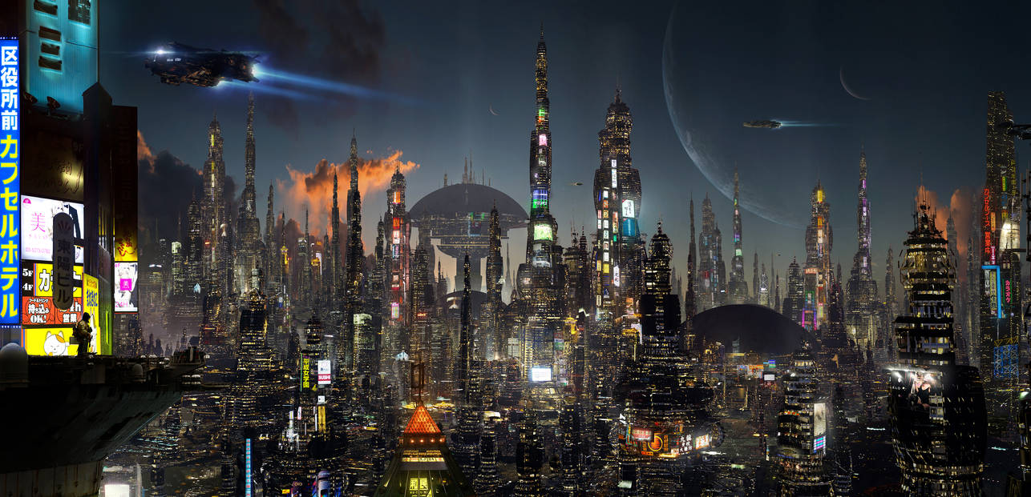
THE FUTURE
AGI & Your Career
Reality Check:
• AGI is likely 10 years away
• Current models are advanced pattern predictors
• True reasoning systems don't exist yet
Industry Reality:
• AI replaces repetitive tasks
• AI augments experts
• Entry-level roles are most impacted

Slide 21
YOUR ADVANTAGE
If you master AI systems deeply,
you will control AI, not compete with it.
Start learning. Start building. Start now.

